Slide 1
TAX ID MAX-SMC
12 Months Bank Statements
Income Calculation

Slide 2
OVERVIEW
TPO Portal
Uploading Documentation
Helpdesk
Ticket Management

Slide 3
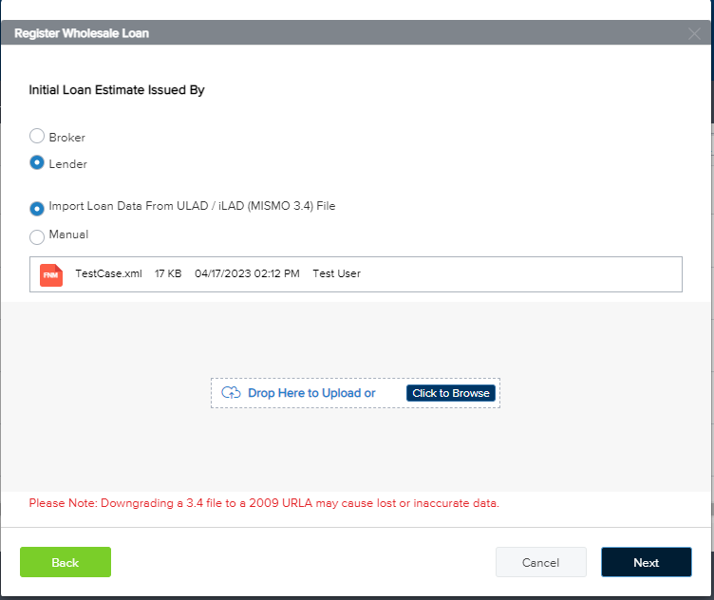
TPO portal
Creating new Loan:
After signing in into your TPO portal, user must add the new file into the pipeline.
This step will define who will be disclosing the file
Lender
Broker
Select the Loan Processor and loan Officer
Choose How the user would like to star the file:
Manually
Importing 3.4 Mismo File.

Slide 4
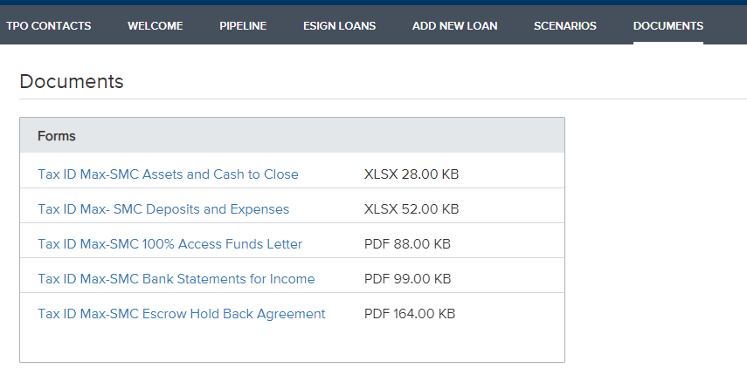
Uploading Documentation
Higlight​
Keep in mind, for the Tax Id Max-SMC the next documentation will be required:
Bank Statement Program - Borrower Business Narrative Submission form
12 months bank statement
Upload this documentation on your left activities panel click the option “Loan Documents”

Slide 5
Helpdesk
Use the helpdesk tool to access and complete the required forms
Verifying your loan status through the Dashboards
Finding the missing information with the Fields look up tool
Sending tickets to request help or to solve doubts for your loans
​

Slide 6
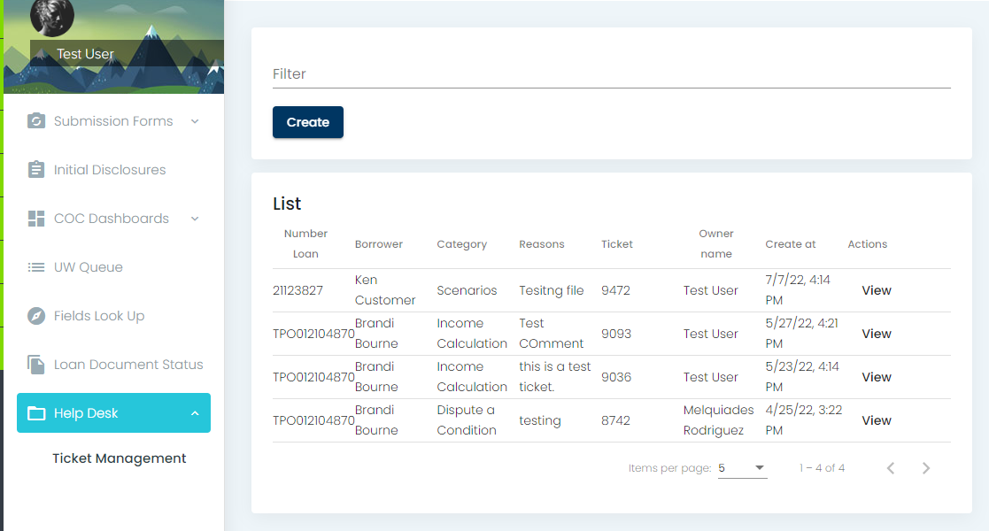
Ticket Management
Sending a Ticket
Select the option Helpdesk to open the option “ Ticket Management”
Create your ticket base on your necessities, Click on “ Create”

